Slide 1
ADT 101: Introduction to the Airframe Digital Twin Concept
13 Feb 2013
Eric Tuegel
AFRL/RQVS
Air Force Research Laboratory

Slide 2
Outline
What is an ADT?
Why an ADT?
Vision of how an ADT might be used
R&D Taxonomy for the ADT
Definitions of Taxonomy elements

Slide 3
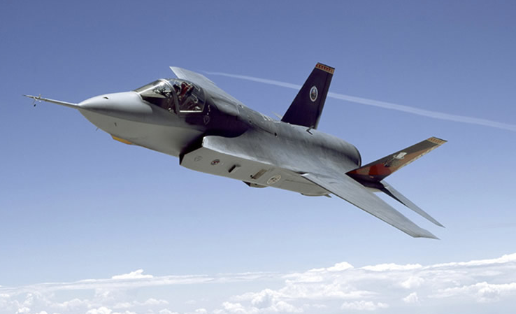
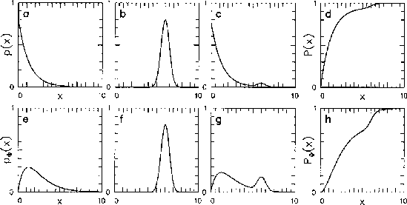
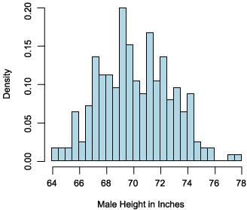
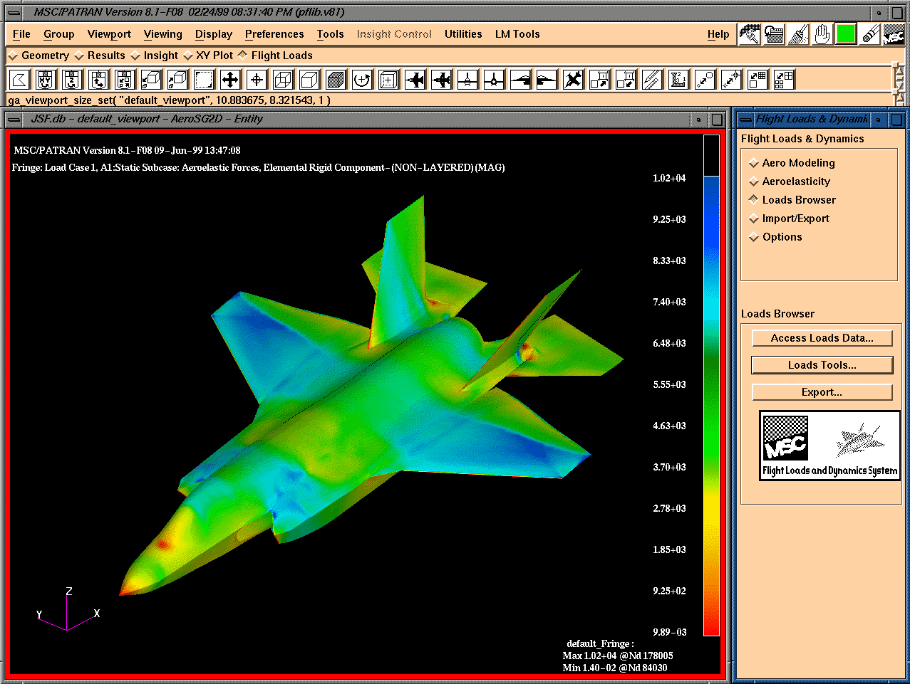
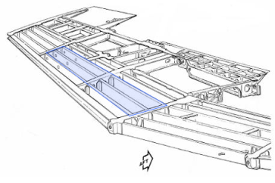
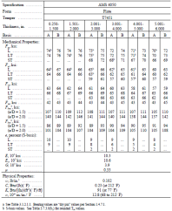
What is an ADT?
Plan Maintenance
Usage
State
Applied Loads & Environments
(Probabilistic)
Update
Update
Range of Structural Response & Reliability
(Probabilistic)
Geometry & Material Data
(Probabilistic)
Physics-based Multi-scale, Multi-Discipline Models
Update
Airframe Digital Twin

Slide 4
ADT Definition
Integrated system of data, models, and analysis tools to represent an airframe over its entire life cycle …
To provide actionable information for making decisions
Now (diagnosis) and for the future (prognosis)
On a fleet-wide and individual tail number basis
Considering all sources of uncertainty

Slide 5
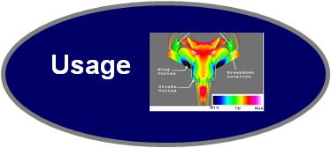
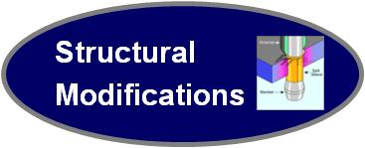
Functional ADT Flowchart
Reliability Sufficient
Update history as new damage state and usage information is gathered
Probabilistic
Decision
Making
Structural Analysis
State of Health
Prognostics History
Remaining Useful Life (RUL)
Health History
Rate of Change
Failure History
Time to Action
Mission History
Problem Identification
Maintenance History
Components Affected
Model Information
Recommendations
Spare Assets
Confidence
Mission Readiness
Remarks/Comments
Reliability Insufficient
Update configuration
Notes:
Damage State Awareness and Usage provides the inputs. Structural Analysis provides the prognostic model. Probabilistic Prognosis & Decisions defines the required outputs from the prognostic model. Structural Modifications result from Probabilistic Prognosis & Decisions and become inputs to the prognostic model for future analyses.

Slide 6
Why an ADT?
Many different information streams over the life of an aircraft
Provide a singe location where all information is collected
Able to find and use the information throughout the lifecycle
Separate information by individual aircraft
Information includes data, analysis models, etc.
Verification and Validation of information is important

Slide 7
Uses of the ADT (1 of 3)
Design
Nominal ADT created as framework for individuals
Use to assess reliability of overall design
Manage design changes
Manufacturing & Assembly
Collect data on individual aircraft as-built
Create unique ADT for each tail number
Use to disposition any discrepancies
Configuration control of individual aircraft
“Digital Thread” Integrating across these Phases.

Slide 8
Uses of the ADT (2 of 3)
Testing & Evaluation
Validate or calibrate models in ADT
Simulate conditions impossible to test
Use to resolve anomalous test results
Use Deterministic, “Design-to” Model Now

Slide 9
Uses of the ADT (3 of 3)
Operations
Force structure planning
Asset selection for mission
Maintenance, Repair & Overhaul
Schedule and Plan Maintenance
Capture field maintenance data
Spares Planning
Design Repairs
Configuration Control of Individual Aircraft
Problem Resolution
Several SPO’s Have Maintenance Databases

Slide 10
ADT R&D Taxonomy
Integrated Architecture
Manufacturing
& Assembly
Sustainment
& MRO
Design
T&E
Operations
Usage
State Awareness
Structural/Life Analysis
Data Management
Computing / Computational Techniques
Probabilistic Support for Decisions

Slide 11
Usage
External macro-conditions applied to and experienced by the aircraft as a whole
Aerodynamic loads
Environmental conditions (humidity, salt spray, etc.)
Heat flux (frictional heating, exhaust impingement)
Applied to ADT as boundary conditions or forcing functions

Slide 12
State Awareness
Knowledge of the condition of the airframe from direct observation
Micro and macro conditions
Initial state from material & process specs, fabrication info w/ process models, design constraints, and NDI
Initial conditions for the ADT
Operational state from NDI and documented evidence of repair or replacement
Continuous validation of the ADT

Slide 13
Structural & Life Analysis
Integrated collection of multi-scale, multi-discipline, multi-fidelity models of the airframe
Quantify uncertainty probabilistically
Outputs: structural displacements, strains, and stresses; evolution of the structural, material, and damage states; and estimates future airframe condition given the proposed usage

Slide 14
Data Management
Architecture and procedures for:
Assuring and maintaining integrity of information
Storing information
Accessing desired information later
Manipulating desired information (visualization, etc.)
Types of information:
Usage (flight records)
State of airframe (inspection records)
Analysis models and results
Maintenance records

Slide 15
Computing
Hardware and software architectures required to efficiently execute the Structural & Life Analysis models, and access information

Slide 16
Probabilistic Decision Support
Approaches for quantifying and managing uncertainty in the ADT
Verification & Validation of ADT
Or possibly calibrating
Tools for making decisions from uncertain information (quantified uncertainty)
Affects:
Model development and execution
Data collection, archiving, and retrieval

Slide 17
Integrated Architecture
Definition and management of the information flow between all components of the ADT, as well as between the ADT and the external world
Service-oriented, modular, open architecture
Securely delivers the right information to the right person at the right time

Slide 18
Design
Definition of the structural configuration
Requirements: original and derived
Design Allowables
Geometry and Tolerances
Materials Specifications
Process Specifications
Developmental testing to support Design Allowables

Slide 19
Manufacturing & Assembly
What is actually built and how it is built
Actual Material Properties (ICME if possible)
Actual dimensions of parts and assemblies
Fit up and shimming
Process controls and records
Discrepancies and dispositions

Slide 20
Test & Evaluation
Certification and Validation of the Design
Ground Tests
Flight Tests
Operational Readiness Tests
Test Conditions and Results

Slide 21
Operations
Aircraft is available and mission capable
Environment while on the ground
Ground handling and Payload loading
Flight loads and environment

Slide 22
Maintenance, Repair & Overhaul
Inspections and maintenance at any location
Inspections and findings
Including disassembly for access
Repairs
Modifications
Program Depot Maintenance

Slide 23
Conclusion
Still a work in progress
The ADT will have many uses – good thing

