Slide 1
Lessons Learned From DARPA SIPS Program – The Need For Integration Across Disciplines
Airframe Digital Twin Workshop
Approved for Public Release, Distribution Unlimited : Northrop Grumman Aerospace Systems Case 12-1952
Elias Anagnostou, Stephen Engel,
John Madsen
Bethpage, NY
Approved for Public Release, Distribution Unlimited: Northrop Grumman Aerospace Systems Case 12-1952

Slide 2
Outline
Structural Integrity Prognosis System (SIPS) Overview
SIPS Management and Technology Integration
Technology Transition Considerations
Success Criteria
Probabilistic Requirements
Verification and Validation

Slide 3
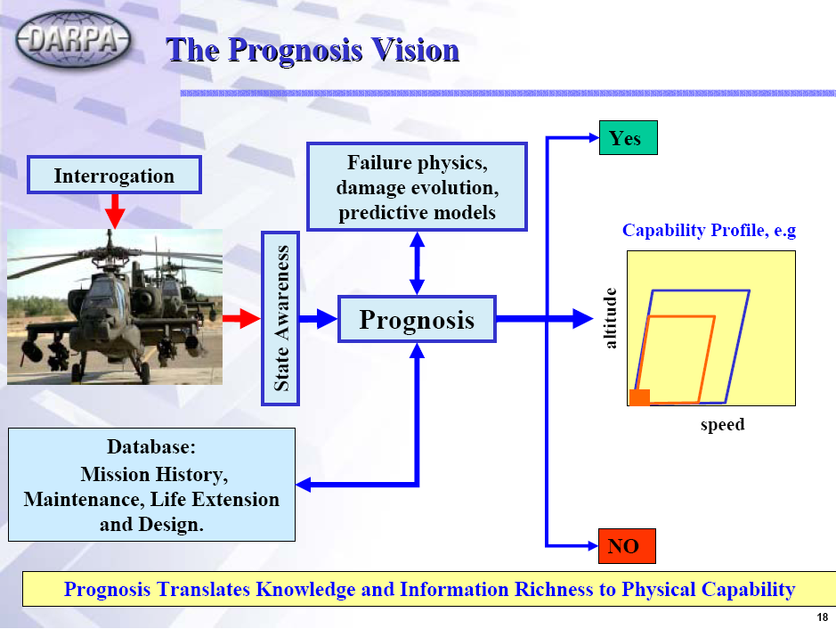

*
* Dr. Leo Christodoulou
Notes:
From DARPA Prognosis Bidder’s Conference, Sep. 26, 2002
Essential philosophy of the prognosis program as developed and articulated by Dr. Leo Christodoulou.
Begins with interrogation of the vehicle in some manner – could be unique sensors or simply the existing flight data recorders. This is converted to state awareness and introduced into the prognosis reasoning module. This information is combined with detailed, physics-based models of the degradation processes – fatigue, corrosion, etc., and any maintenance history and structural characteristics. The reasoner module uses these “uncertain” inputs to provide a “near-term” prediction of the capability of the vehicle. Is it safe to fly or not, can it be exercised through the full range of its capabilities or must it be restricted.
We have tried to adhere to this philosophy in our development efforts, as I will try to explain.

Slide 4
How Does SIPS Work?
SIPS fuses all forms of evidence about the health and usage of components with models that capture the physics of failure while accounting for the uncertainties in each to produce a probabilistic assessment of health at any time – past, present or future.
Bayesian reasoning
methods for learning and
updating predictions codified
in patented methods
for fast computation
Component usage,
in situ defect sensors,
virtual sensing, NDI,
performance sensors,
environmental data,
maintenance actions….
Science-based modeling that
accurately captures details of
materials microstructure and
degradation processes

Slide 5
SIPS Approach
SIPS fuses all forms of evidence about the health and usage of components with models that capture the physics of failure while accounting for the uncertainties in each to produce a probabilistic assessment of health at any time – past, present or future.
OUTPUT:
Current and future state probabilities

Slide 6
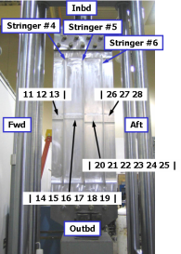
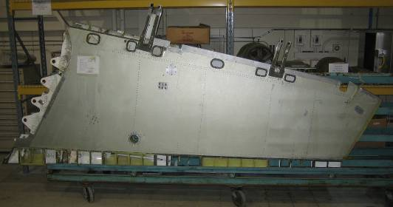
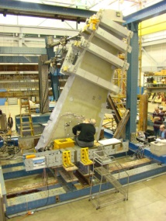
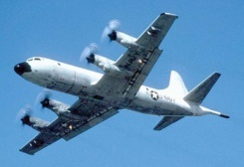


Research Progression to Flight Demonstration
HIERARCHICAL APPROACH TO VALIDATION FROM COUPON TO COMPONENT TO SYSTEM LEVEL
PAX P-3
Zone 3 & 5
19.23” x 60”
TEARDOWNS OF RETIRED EA-6B OUTER WING PANELS
3 FULL-SCALE TESTING OF EA-6B OUTER WING PANELS
24 MONTH P-3 FLIGHT DEMONSTRATION
COUPONS, ELEMENTS AND SUBCOMPONENTS
2003
Φ1
Φ2
Φ2+
2010
Oct 2011 →
Disciplines
  Structures
  Material Science
  Manufacturing
  Characterization and Testing
  Computer Science
  Information Management
  Mathematics
  Sensor Sciences

Slide 7
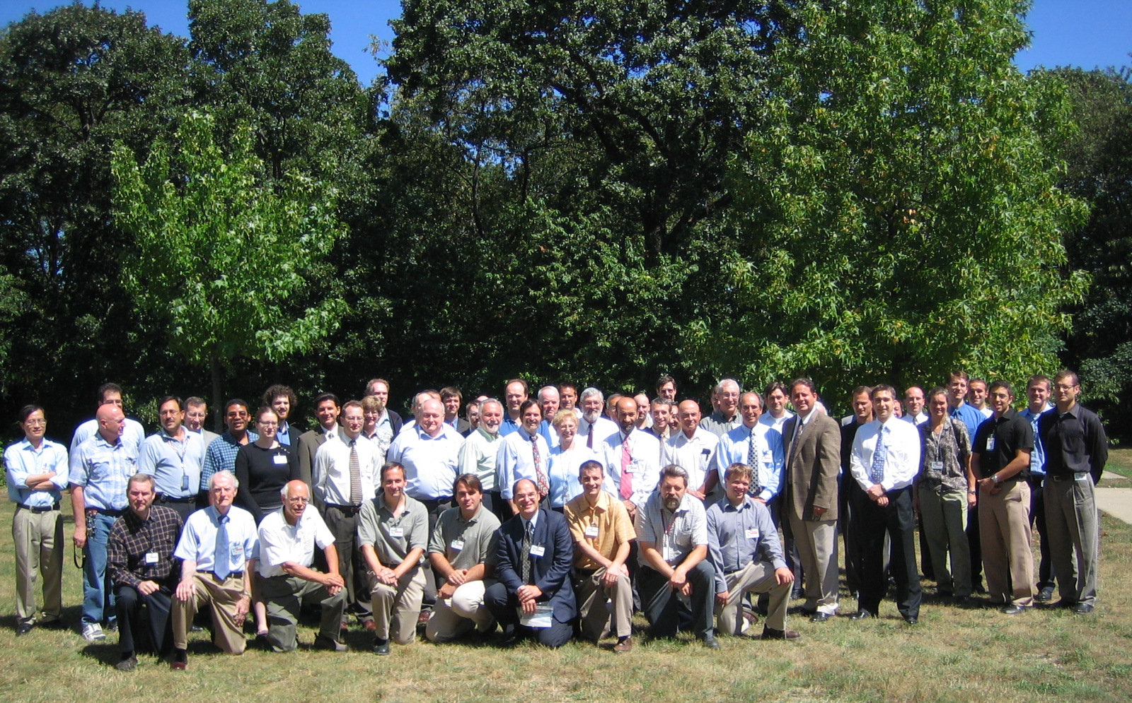
Program Organization
Prognosis Program
Program Manager - Madsen
Principal Scientist - Papazian
Materials & Modeling
Anagnostou
Sensor Systems
Silberstein
Reasoning & Predictions
Engel
System Architecture
Teng
Demonstrations
Anagnostou
Engel
An integrated team of ≈ 75 engineers, scientists, professors and graduate students

Slide 8
Program Organization
Material & Modeling
Members
Role
ALCOA / Weiland
Material Characterization Structure-Property
Microstructure characterization & creation of data for a statistical &/or direct representation of microstructure. Characterize damage progression.
Prognosis Program
Program Manager - Madsen
Principal Scientist - Papazian
Cornell / Ingraffea
Continuum Models Web-Based Simulation,
Multi-Scale Integration
Multiscale modeling, crack initiation & growth analysis, probabilistic crack growth modeling.
MSU / Horstemeyer
Atomistic Simulation Microstructural Models, Multi-Scale Integration
Multiscale analysis using internal state variables. Define matrix for microstructure-property model development.
Materials & Modeling
Anagnostou
Sensor Systems
Silberstein
Reasoning & Predictions
Engel
System Architecture
Teng
Demonstrations
Anagnostou
Engel
Lehigh / Wei, Harlow
Corrosion/Corrosion Fatigue Stochastic & Probability Corrosion Testing
Mechanistic modeling of corrosion & corrosion fatigue. Stochastic & Probabilistic effects. Corrosion-fatigue testing.
RPI / Maniatty
Crystallographic Deformation
Development of 3-D mesoscale (polycrystalline) finite element models of crystallographic deformation.
CMU / Rollett
Microstructure Builder
Methods for constructing 3-D representations of materials microstructures. Statistically representative materials microstructures.
OSU / Buchheit
Corrosion
Characterization of corrosion parameters and development of mechanistic models for localized corrosion.
UVa / Gangloff
Fatigue Damage Characterization
Experimental characterization of nucleation, small crack growth, crack crystallography, environment effect.
An integrated team of ≈ 75 engineers, scientists, professors and graduate students
VEXTEC / Tryon
Fatigue Models
Probabilistic microstructural-based fatigue life prediction model.

Slide 9
Program Organization
Sensor Systems
Members
Role
Prognosis Program
Program Manager - Madsen
Principal Scientist - Papazian
JENTEK / Goldfine
Meandering Wire Magnetometers
Electromagnetic characterization of metals & dielectrics. Meandering wire magnetometer & giant magnetostrictive sensors & data analysis.
OCEANA / Lally
Ultrasonics, Wireless Networks
Design, & integrate wireless sensors Statistical analysis of measurement results.
Materials & Modeling
Anagnostou
Sensor Systems
Silberstein
Reasoning & Predictions
Engel
System Architecture
Teng
Demonstrations
Anagnostou
Engel
Ultra Electronics / Rees
Acoustic Emissions
Flight test sensor system using passive acoustic emissions
MATECH/ UPenn / Berks Laird DeLuccia
Electrochem Fatigue
Provide Electrochemical Fatigue Sensors
Georgia Tech / Michaels
Nonlinear Ultrasonics
Active/passive ultrasonics & acoustics. Models for attenuation, backscatter, nonlinear techniques, acoustic emission. In-situ sensors.
Triton Systems / Powell
Composite Sensors
Develop composite-specific sensor systems
An integrated team of ≈ 75 engineers, scientists, professors and graduate students
Quantum Magnetics / Vierkotter
Large-Area Strain
Optimize non-contacting quadrupole (QR), magnetic resonance (MR) sensing.

Slide 10
Program Organization
Reasoning and Prediction
Members
Prognosis Program
Program Manager - Madsen
Principal Scientist - Papazian
Role
Impact Technologies / Roemer
Diagnostics / Prognostics
Signal processing, state awareness & prediction models, model adaptation
Georgia Tech / Vachtsevanos
Power Trains
Critical drive train, prediction confidence methods, diagnostics & prognostics metrics
Materials & Modeling
Anagnostou
Sensor Systems
Silberstein
Reasoning & Predictions
Engel
System Architecture
Teng
Demonstrations
Anagnostou
Engel
Physical Sciences / Rietman
Virtual Sensors, meta models
Empirical mapping methods, virtual sensors, meta models, hierarchical uncertainty management
PSU ARL / Mark
Vibration Modeling
Modeling vibration response to planetary gear defects for power trains
UMD/ Coker
Power Train Experimentation
Transmission, gears and bearing test laboratory for power train validation
Sikorsky/ Davis
Helicopter validation
Experimentation, lab and aircraft power train prognosis validation
An integrated team of ≈ 75 engineers, scientists, professors and graduate students

Slide 11
Program Organization
Prognosis Program
Program Manager - Madsen
Principal Scientist - Papazian
System Architecture
Members
Role
Members
Role
Materials & Modeling
Anagnostou
Sensor Systems
Silberstein
Reasoning & Predictions
Engel
System Architecture
Teng
Demonstrations
Anagnostou
Engel
NGC ACS / Teng
Overall Architecture
Open Systems Architecture, infrastructure, security, multi-site communications, collaboration environment, user interfaces.
Cornell / Ingraffea
Modular Web Services
Distributed modeling web services, advanced visualization, adaptive software, & digital material format definition.
An integrated team of ≈ 75 engineers, scientists, professors and graduate students

Slide 12
Program Organization
Prognosis Program
Program Manager - Madsen
Principal Scientist - Papazian
Demonstrations
Members
Role
NGC EA-6B / Warren
Anagnostou
EA-6B outer wing panel lower cover structural engineering support
Materials & Modeling
Anagnostou
Sensor Systems
Silberstein
Reasoning & Predictions
Engel
System Architecture
Teng
Demonstrations
Anagnostou
Engel
Sikorsky / Davis
NAVAIR /Hardman Engel
H-60 carrier plate analysis and testing
Sikorsky / Schaff
Whiteside
Helicopters
H-60 composite flex beam analysis and testing
NAVAIR / Hoffman, Rusk
EA-6B outer wing panel full-scale testing at Patuxent River NAS
NAVAIR / Phan
24 month P-3 Flight Demonstration at Jacksonville NAS
An integrated team of ≈ 75 engineers, scientists, professors and graduate students

Slide 13
SIPS Integrated Management Approach
Quarterly reviews to government – DARPA, NAVAIR, ONR, AFRL, AFOSR, ARMY, FAA
Continuous contact with DARPA, NAVAIR, and Advisory Board
Continuous contact with our team members
  Group TIMs prior to quarterly reviews
  Thrust area TIMs every 6 months or as needed
  Bi-weekly teleconferences with team members
  Visits to team member facilities
Technical Planning
  Define system architecture, communication protocols
  Define experimentation and characterization effort, what is needed by whom and when
  Define team members roles, collaboration, source of inputs, outputs, variance of output
  Plan Milestone Demonstrations, sequence of demonstrations, who will be involved
  Provide data and information to team members

Slide 14
M & S Group Integration and Major Tasks
Corrosion
Science
Mechanical
Properties
Experimental
Characterization
Lehigh
OSU
WSU
MSU
RPI
Cornell
NGC
CMU
VEXTEC
GT
Alcoa
UVa
Atoms Structural
Scale

Slide 15
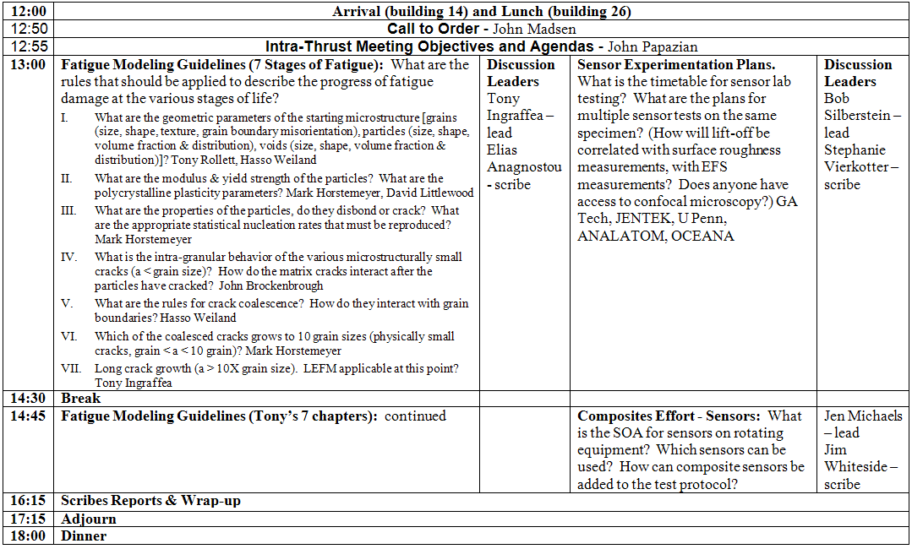
Intra-Thrust TIM – 2nd Quarter

Slide 16
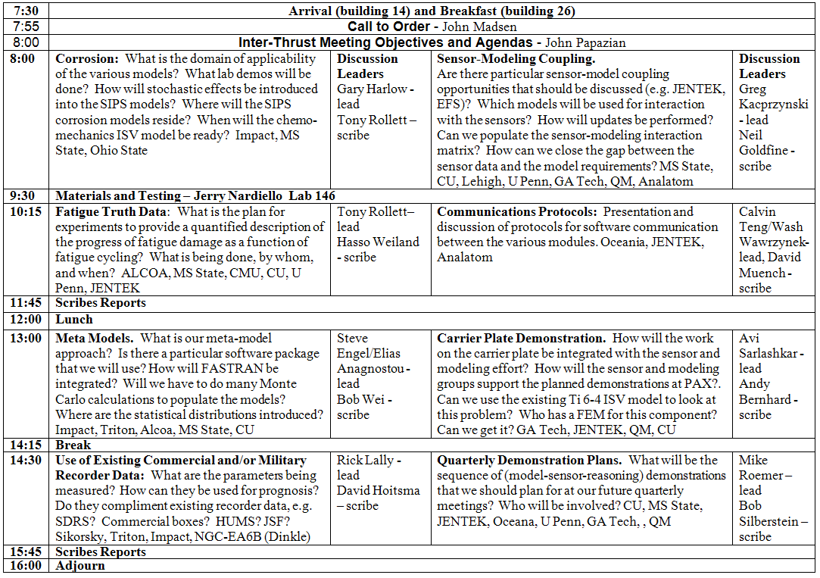
Inter-Thrust TIM - 2nd Quarter

Slide 17
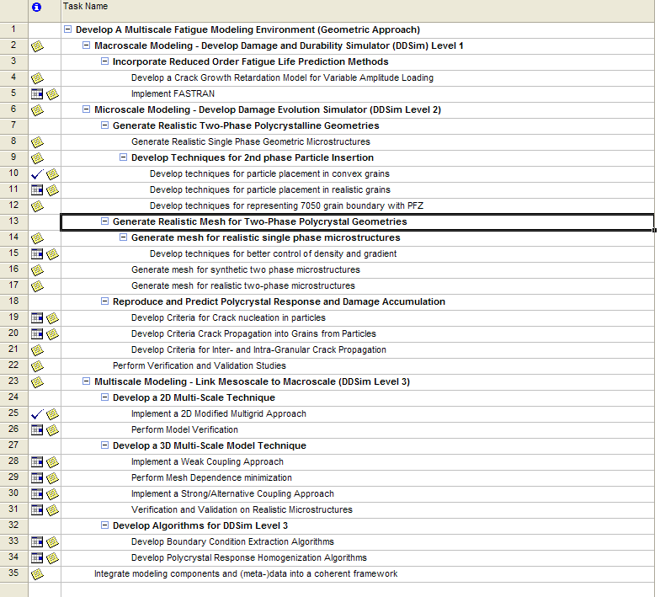
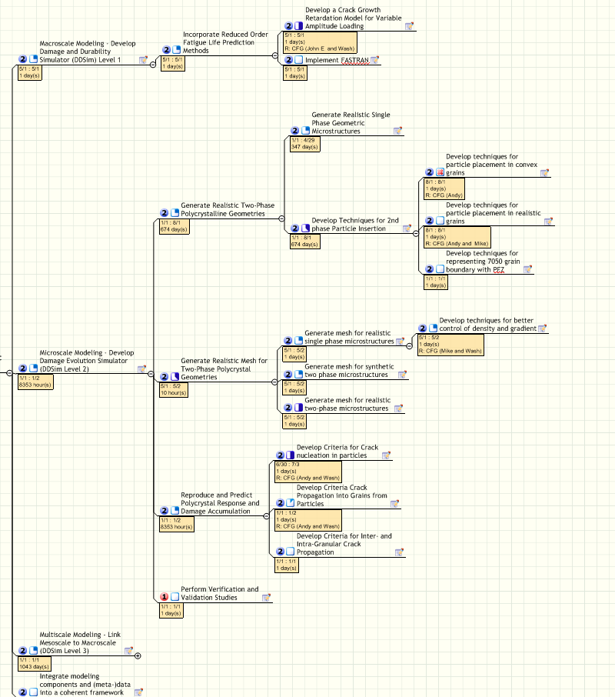
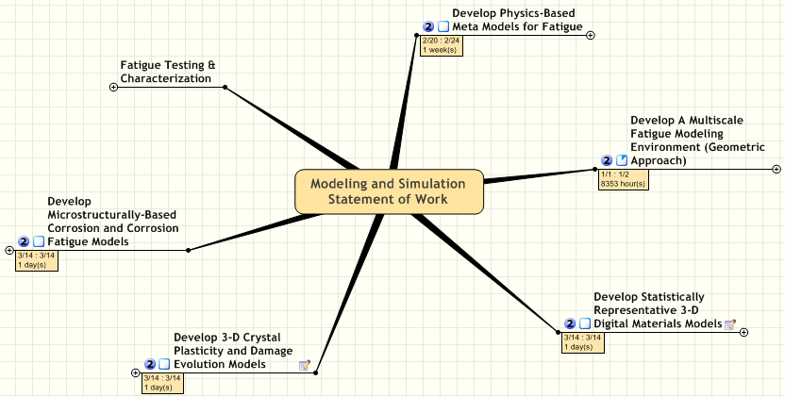
Materials & Modeling Statement of Work

Slide 18
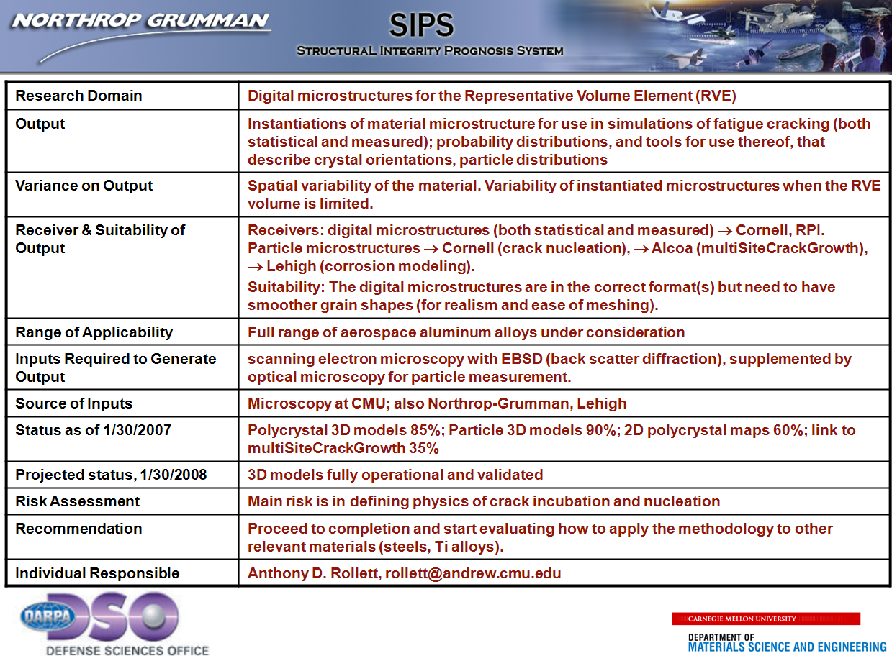
Quarterly Reviews - Second Slide

Slide 19
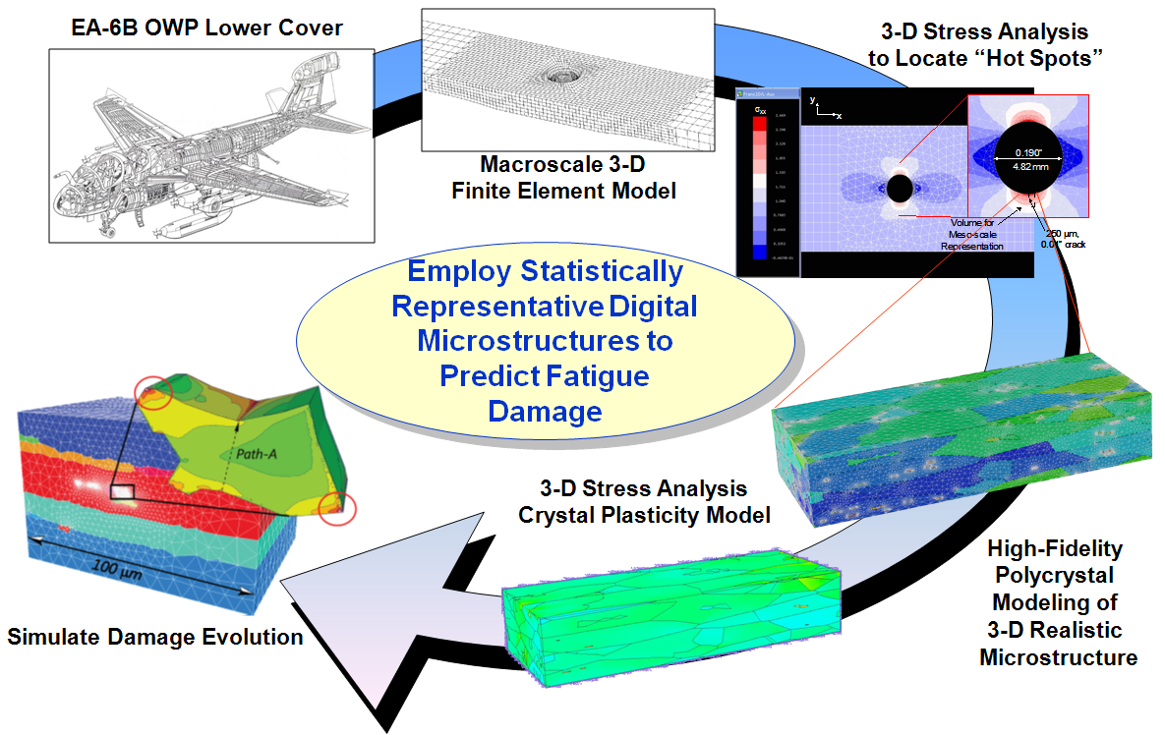
Multi-Scale Modeling: Geometric Approach
Relate microscopic and macroscopic stress and strain fields
Local damage to global structural failure

Slide 20
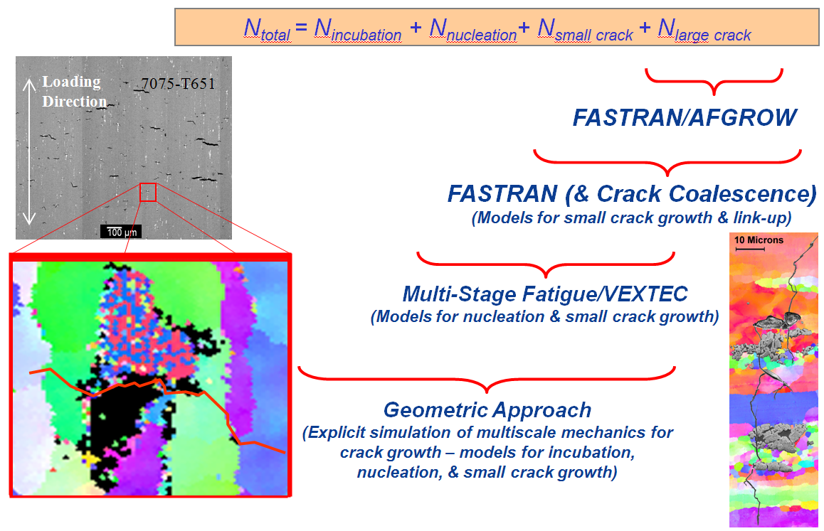
Multi-Physics & Multi-Disciplinary Science
Mechanism-based models
Holistic consideration of damage

Slide 21
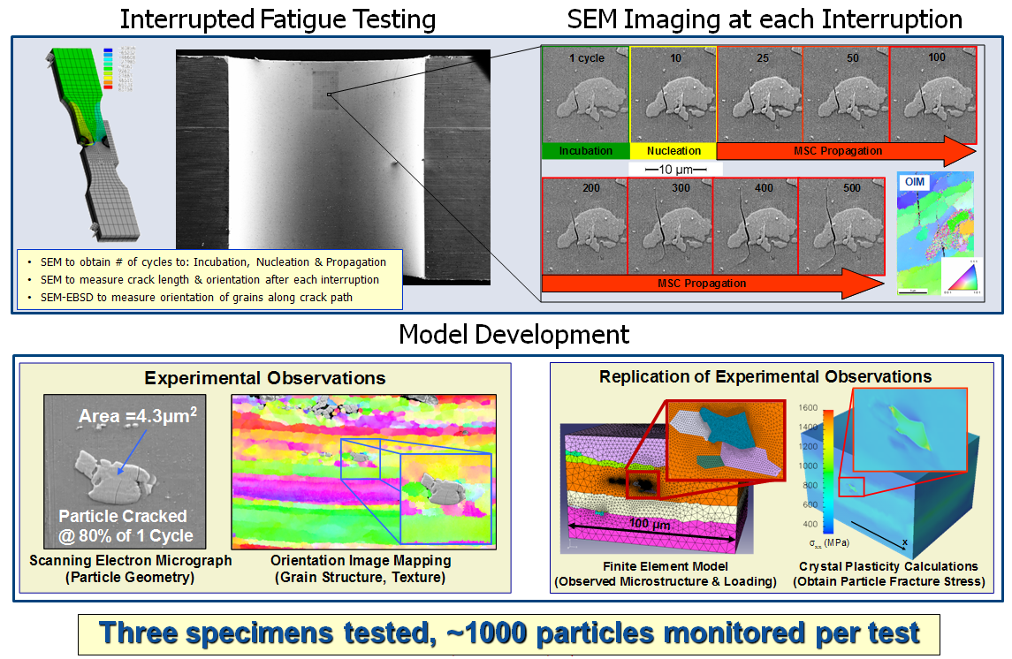
Investigation of Damage Mechanics
Experimental methods to characterize damage evolution
Calibrate fatigue models at various length scales/damage mechanisms

Slide 22
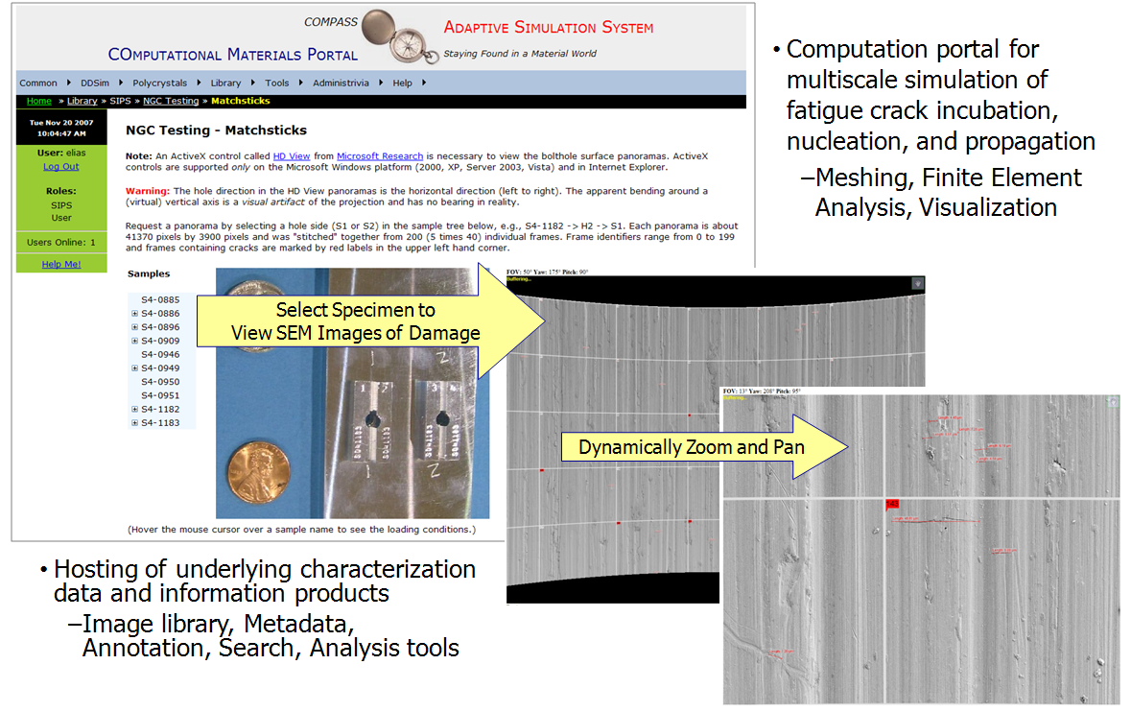
Computational Framework & Shareable Database
Damage and Durability Simulator
3-D microstructure builder
Damage models
Visualization
Database

Slide 23
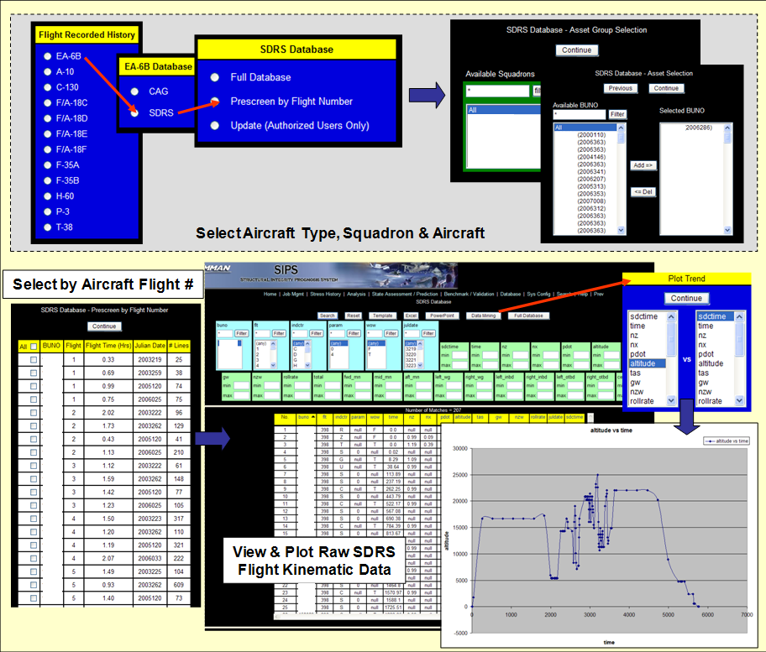
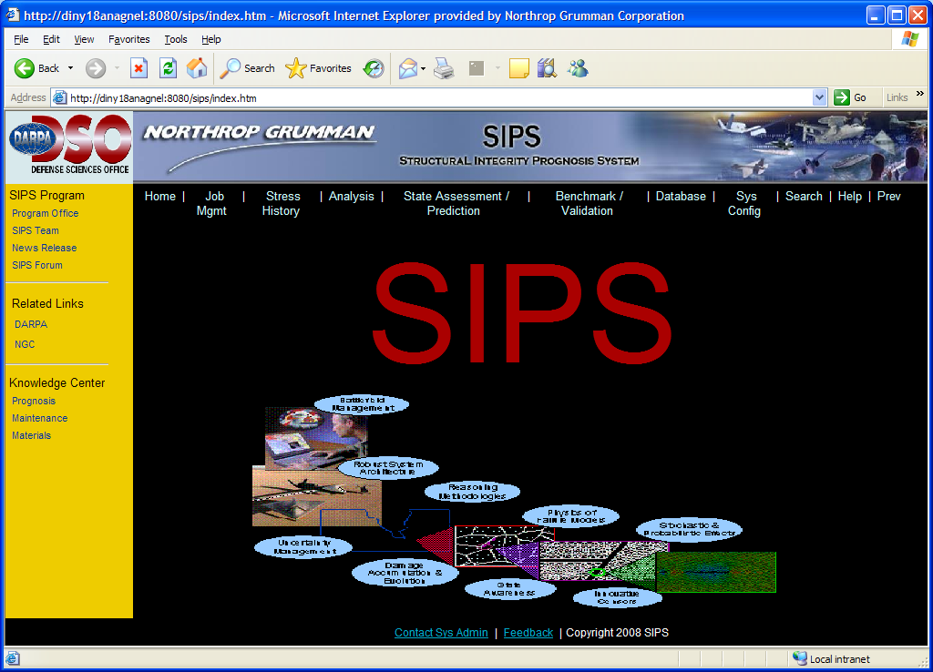
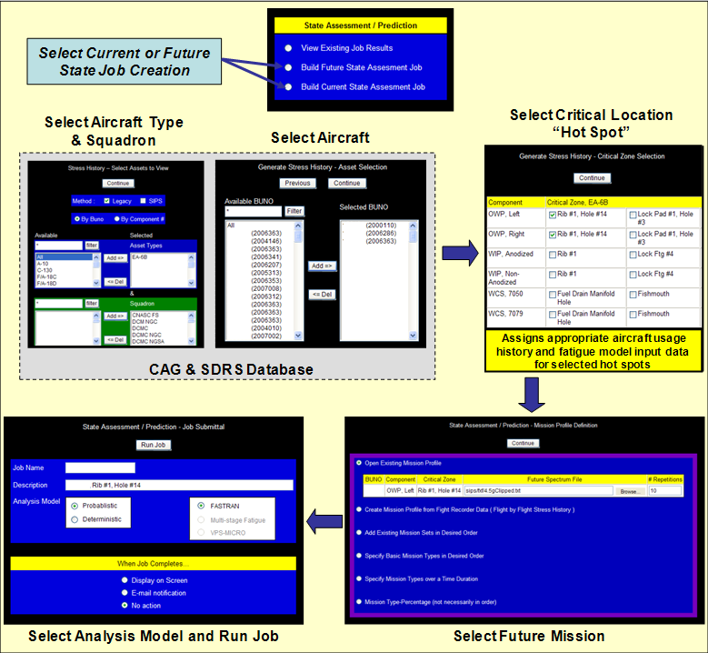
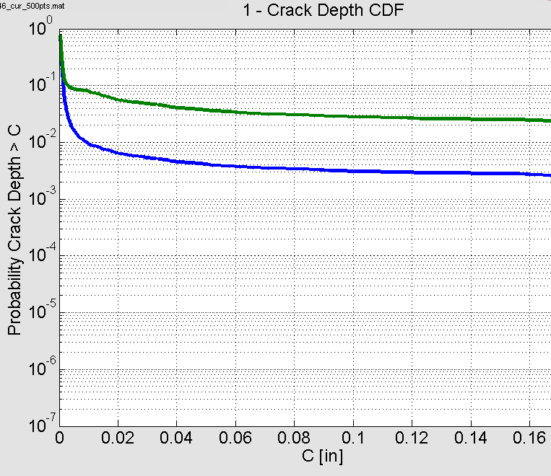
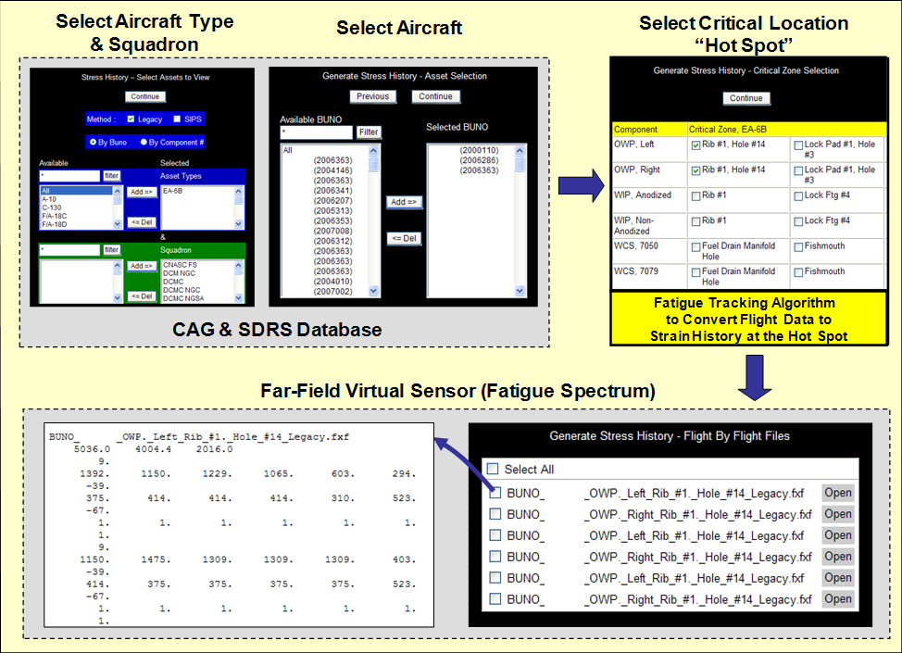
Prognosis Prototype Web-Based System
model with positive indication
model alone
Main Functions
model with negative indication
Stress
History
Analysis
State
Assessment
Prediction
Benchmark/Validation
Database

Slide 24
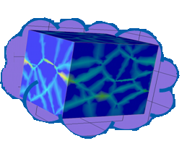
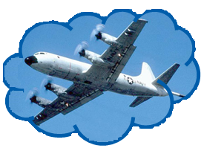
Balancing Science and Engineering
Northrop Grumman
Academia,
Scientists
Budget-Schedule-SOW
DoD Practitioners
DoD

Slide 25
Technology Transition Considerations
Engage and listen to your transition customer
  Transition plan founded on the customer's corporate practices needs to be defined at the outset with appropriate resources dedicated
  Plan ahead for transition funding
Let Business Case Analysis drive functionality and requirements
  Ultimate goal is to provide actionable insights/intelligence to maintain aircraft at max availability while ensuring structural integrity at lowest cost
Formulate concept of operation(s) up front
  Identify appropriate stakeholders and get them onboard as well as their issues/objections/requirements/needs
Use disciplined System Engineering processes
  Properly integrate requirements and interfaces among various engineering and logistic stakeholders
Tie in existing processes
  Fundamental for Navy is RCM-based processes which will drive maintenance scopes/actions for implementation and compliance
  Graduated deployment

Slide 26
Technology Transition Considerations
Data, Data & Data – Determine what, how much, and what are we going to do with it.
  Develop a plan for collection, QA, processing, analysis, what action to take with those data.
  Strive for min data/sensors with biggest/largest insights.
  What do we do with missing data, with conflicted data from different sources (data hierarchy, inferred vs direct, etc)
  How to share/display for specific end users from a single "integrated" data bank
-Configuration, Configuration, Configuration
  Need to serialize, identify, locate and assess/monitor condition over time (who should be responsible for this?)
  How should we automate data collection to avoid human errors and lessen burden on the fleet
V&V – Where do we draw the limits?
  Must keep engineering from going overboard (not an automated NDI system!),
  What's "good enough“ with respect to the end objective(s) –
  Engineering & logistic community must be open-minded enough to take advantage of what we could offer
After transition
  Support and sustainment of the infrastructures are the key to survival/success along with generating additional values to the stakeholders

Slide 27
Start With Clear And Measurable Success Criteria
SIPS Goals
  Phase I → 2X better than current practice
  Phase II → 5X better than current practice
  Both goals were ambiguous and not verifiable
P-3 Follow On Contract Goal
  Evaluate the “Utility” of the approach
  Utility – real-valued function on prospects
    Bounded
    Ordered according to preference
    Computed as an expected value for prospects that are random
  Utility can be added to Bayes Nets to form Influence Diagrams
  Since parameters (costs etc.) were not quantified, results were promising but anecdotal
New ONR IHSMS contract is requiring something measurable:
  Uncertainty quantification and business case analysis

Slide 28
Suggested Top-Level Requirements for Prognosis
Four Key Requirement Parameters
Max Probability of Failure
  Taking action before this point limits risk (avoids taking actions too late)
Max Probability of Unfounded Maintenance
  Taking action after this point limits unnecessary maintenance (avoids taking actions too soon)
Lead time
  Provides sufficient time to plan maintenance, manage resources & order spares
Prediction confidence
  Specifies the probability that your answer will be correct
It is also useful to have a clear definition of failure or end of useful life

Slide 29
Max PoF
Limits Risk
Pof_{max} is the maximum probability of failure:
t_{max} is the point in time where the probability of failure = Pof_{max}
Pof_{max} = area shaded blue
Expected Failure Time
Failure pdf
t_{max}
Probability of failure avoidance = red area
Damage
Failure threshold
Any point to the left satisfies this requirement
Time

Slide 30
Max Probability of Unfounded Maintenance
[1 – Max Probability of Unfounded Maintenance] = p_{min}
t_{min} is the point in time where the probability of failure = p_{min}
p_{min} = area shaded blue
Failure pdf
t_{min}
t_{max}
Probability of unfounded maintenance = red area
Damage
Failure threshold
Any point to the right satisfies this requirement
Time

Slide 31
Compliance Interval Satisfies Both
The requirements are satisfied as long as we design our prognosis algorithms to predict any time in the compliance interval.
t_{min}
t_{max}
Failure pdf
Damage
Failure threshold
Too soon
Too late
Compliance interval
Time
Is there an ideal point for validation?

Slide 32
Just-In-Time Point & Lead-Time
Just-In-Time Point
Actions should be taken here
Just-In-Time point
is the time where the failure is predicted to occur L_{t} hours in the future with a probability of:
[Pof_{max} + p_{min} ]
2
Lead Time L_{t}
t_{min}
t_{max}
Failure pdf
Current time
Damage
95%
Failure Threshold
Compliance interval
Time
t₀
t_{a}

Slide 33
Validation & Verification Procedure
Choose a desired confidence level for V&V
Using n components from the field, count
the number that have failed on or before the
predicted point → (Pof_{max} + p_{min})/2
Using the adjusted Wald method (or
equivalent), estimate the probability of
failure p and its confidence bounds p_{low} and
p_{up} from the test/field data in step 2.

Slide 34
Estimating the True PoF Using Field Data
As more field data are used, the estimate of the probability of failure and the upper (P_{up}) and lower (P_{low}) confidence bounds converge on the true probability
p_{low}
PoF
estimate
p_{up}
Number of components
10
0
0.05
0.1
0.15
0.2
0.25
0.3
0.35
0.4
30
0
0.05
0.1
0.15
0.2
0.25
0.3
0.35
0.4
50
0
0.05
0.1
0.15
0.2
0.25
0.3
0.35
0.4
100
0
0.05
0.1
0.15
0.2
0.25
0.3
0.35
0.4
500
0
0.05
0.1
0.15
0.2
0.25
0.3
0.35
0.4

Slide 35
V&V Analysis
Requirement:
p_{min} Pof_{max}
Probability of Failure
p_{low}
p_{up}
Requirement satisfied to desired confidence
Requirement satisfied to Lesser confidence – need more field data
Test Data
Won’t meet requirement with desired confidence
Design meets requirements to desired confidence when [P_{low} & P_{up}] are within [P_{min} & Pof_{max}] as determined L_{t} hours in advance

